Slide 1
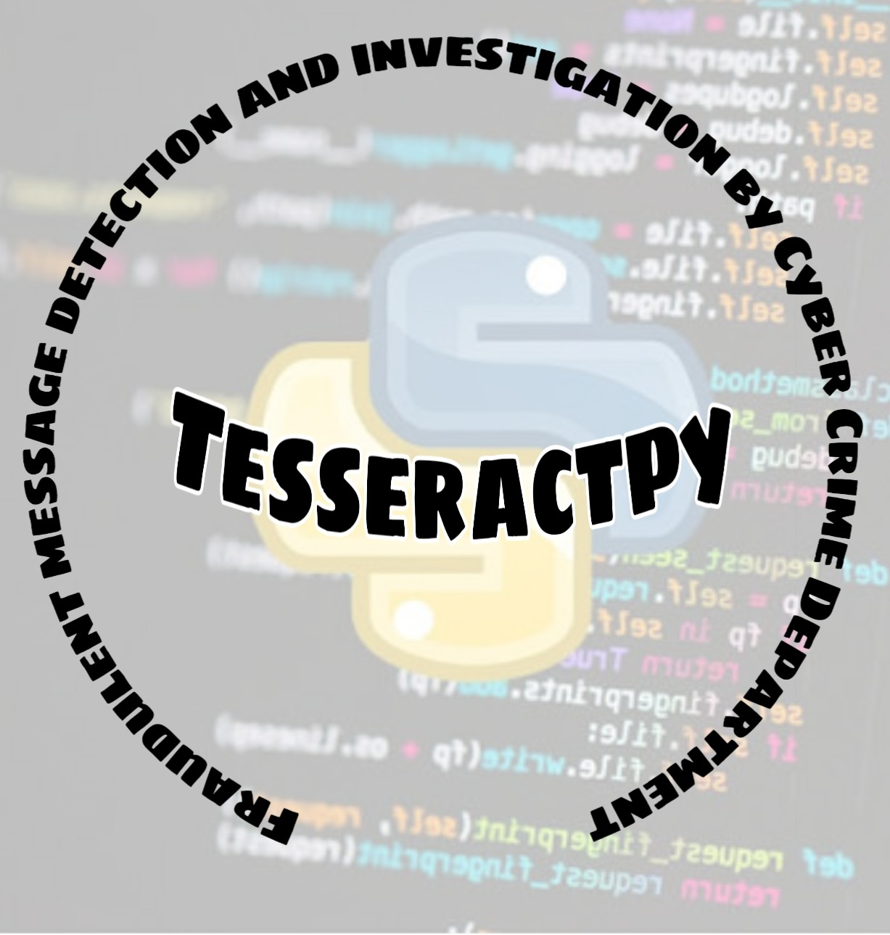

Slide 2
Fraudulent Message Detection and Investigation
By Cyber Crime Department
Team Name: Tesseractpy
Team Members: Abhishek Ramesh Yadav
Hiren Nitin Shukla
Akshay Chintamani Adkurkar
Nitish Indrasan Singh

Slide 3
Problem Statement:
Fake/Obscene news/content tracker:
In this age of internet and social media, it’s easy to propagate fake news, which leads to chaos and unrest everywhere moreover deep fakes and anonymity has made it easy for perpetrators to peddle fake news and upload obscene content without much difficulty, an efficient solution is required to trace, block the origin of fake news, obscene content, deep fakes etc from various social media platforms, mobile apps etc so law enforcement agencies can take appropriate action.

Slide 4

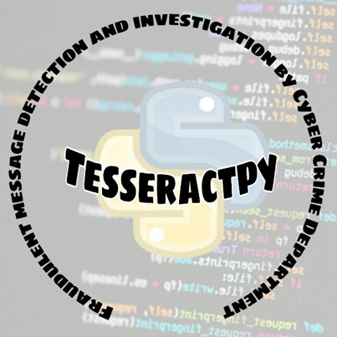
Social Media:
Connects people
Medium of Sharing information
User-Generated Content(UGC)
Promotes professional/personal commerce

Slide 5

But What if Social Media became a victim for Disputing And Misleading content Source
Triggering Riots in Nation
Social Media Rumours
Disputing posts
Spreading Fake news

Slide 6
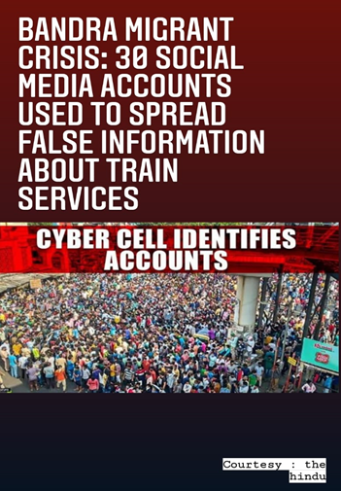


Disputes took placed because of the Existing problems on social media:

Slide 7
Proposed Idea and Architecture

Slide 8
Social Media App
GPS Access Primary Requirement
Admin Panel
User Interface
Reported Messages
Blocked Messages
Capture IP & GPS Coordinates
Sender & Initial Sender
Sender Side
Message
Sentiment Analysis + Keyword Matching
IP & Credential
Location Tracking
Disputed
Non-Disputed
After Certain Count
Keyword is added
Message Blocked
Positive
Negative
Keyword Extraction
Message sent to Receiver

Slide 9


Challenges Faced
Data protection
End-to-End Encryption
User’s Privacy

Slide 10
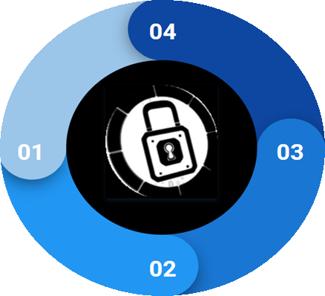
How we Overcome those Difficulties
TF Lite Model
No Message Content is shared with External server
Predictions made
Locally
End-to-End privacy is
maintained

Slide 11




Technologies Being Used:
Android
Tensorflow Lite
Python
Firebase Database
Firebase Authentication

Slide 12




Advantages of Proposed Idea:
Blocking Disputed Messages/Posts
IP address of user is fetched
Initial Sender is fetched
Location of user can be tracked
Gives faster results
Requires Less space
User’s privacy is maintained
End-to-End Encryption is maintained
Disputed Content
Initial Sender

Slide 13
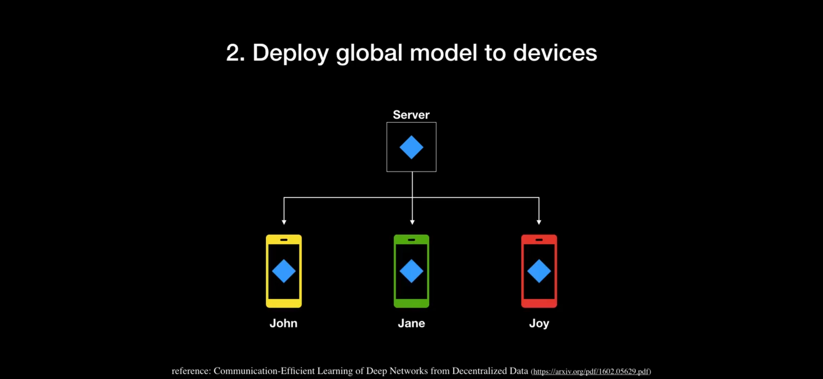
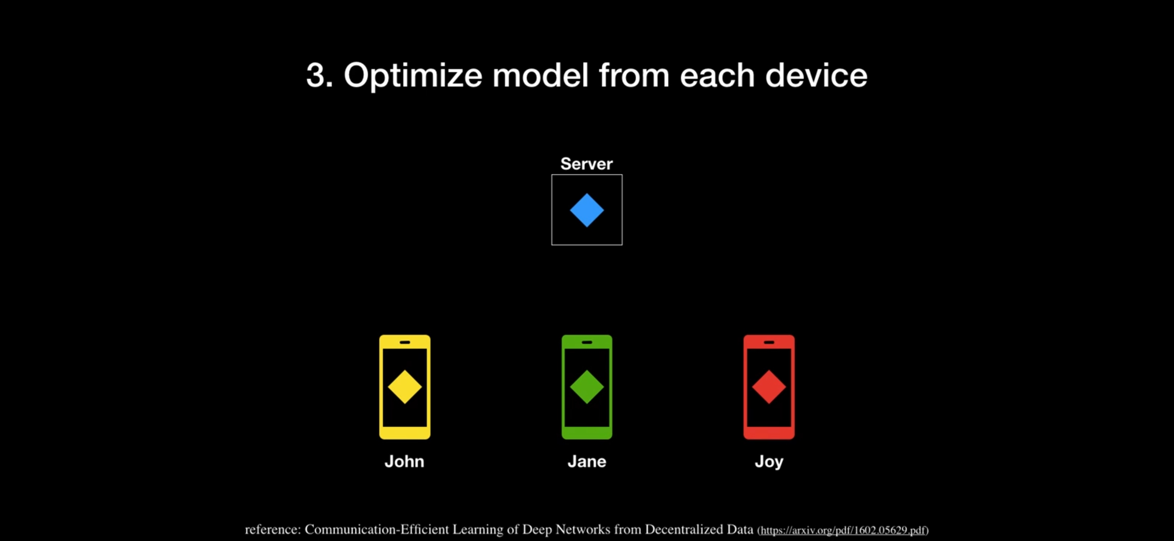
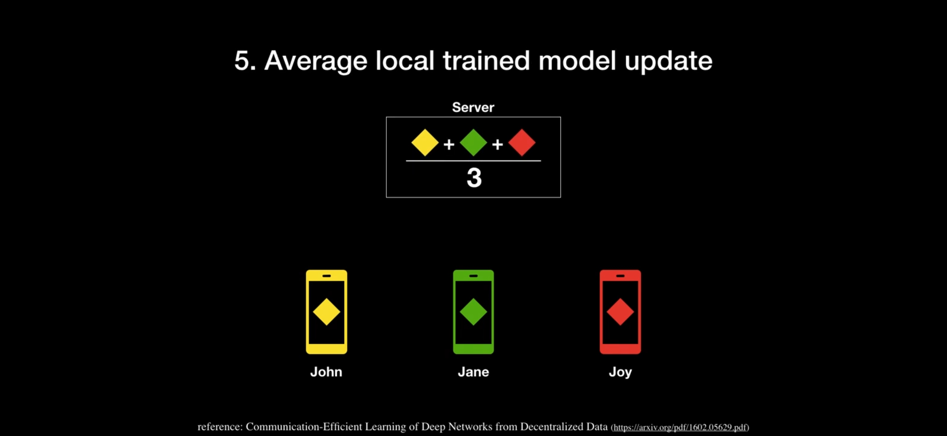
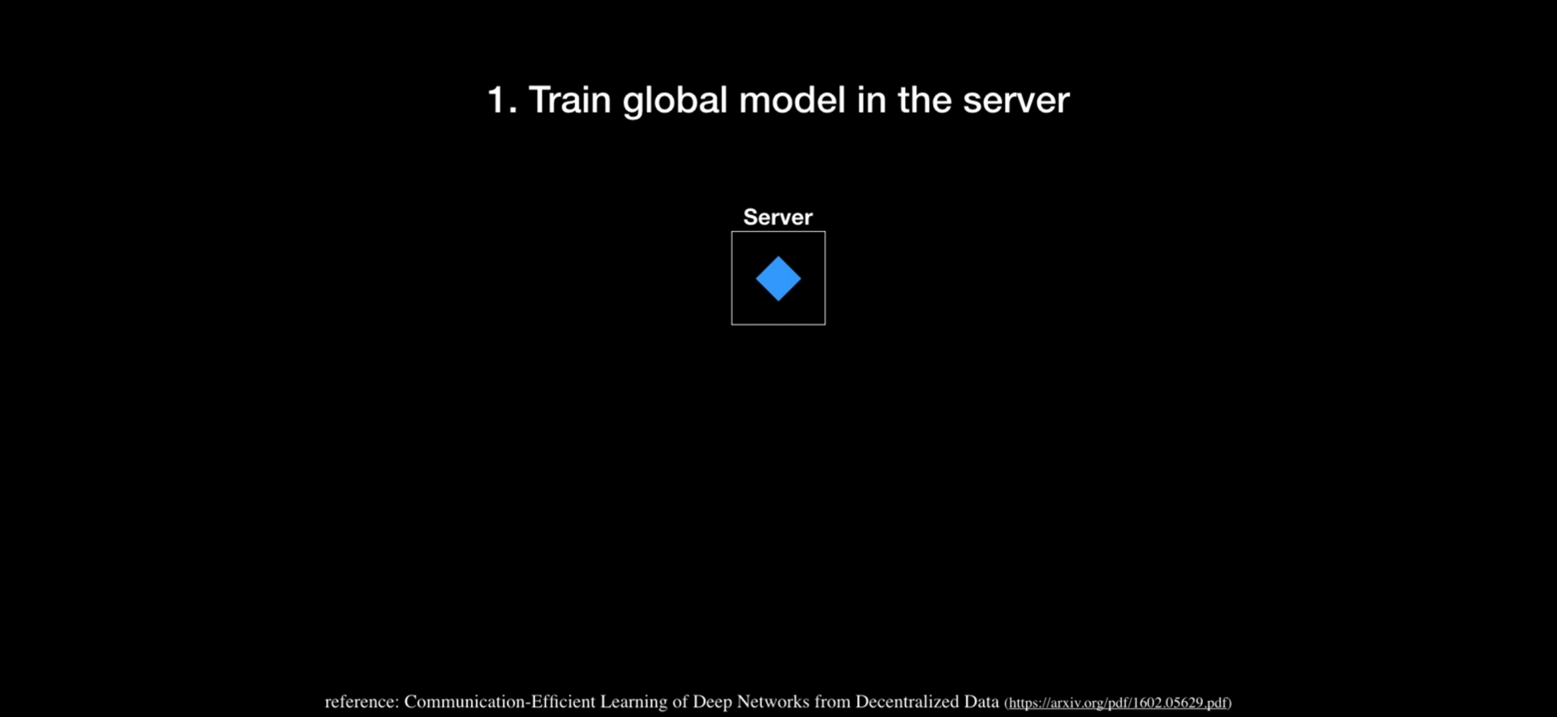
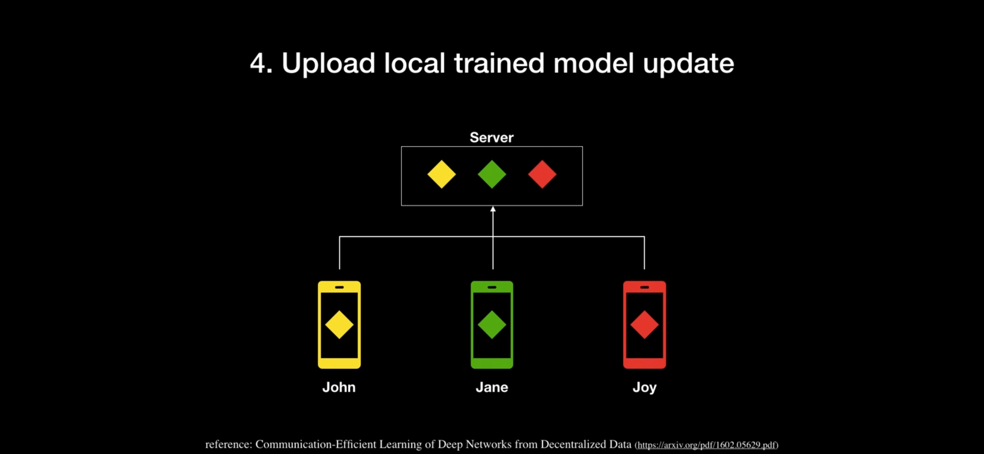
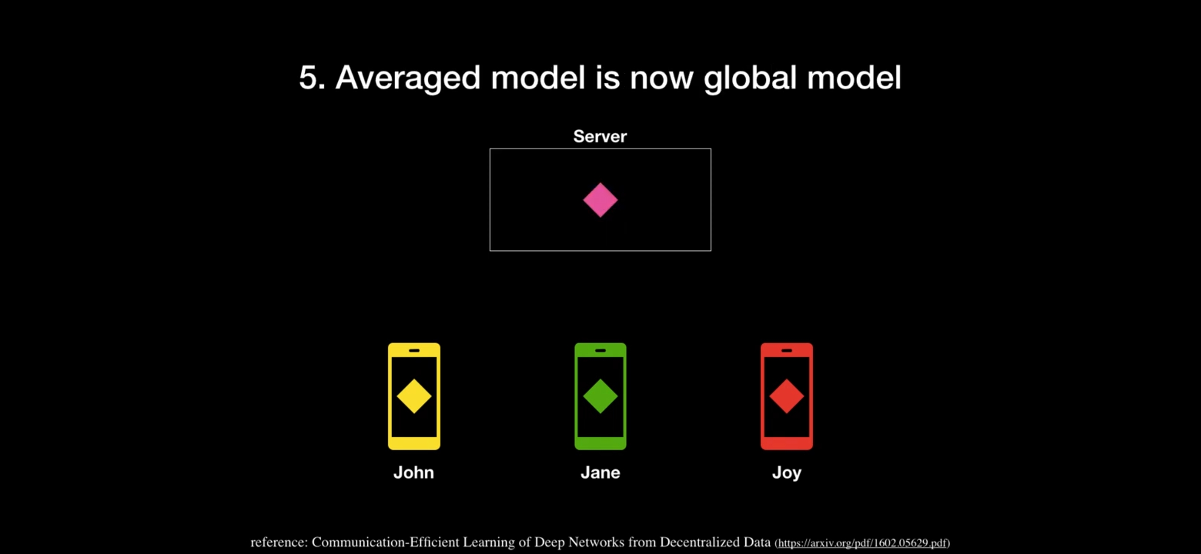
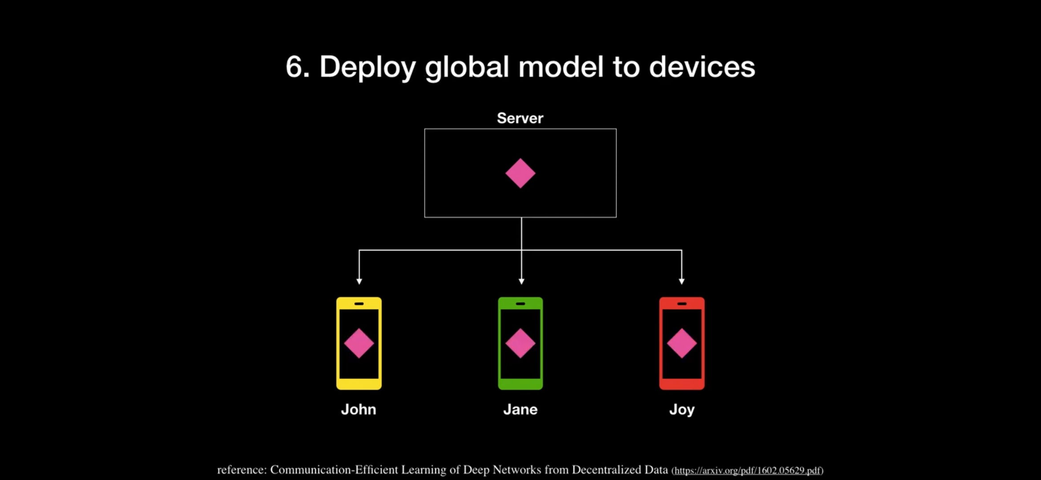
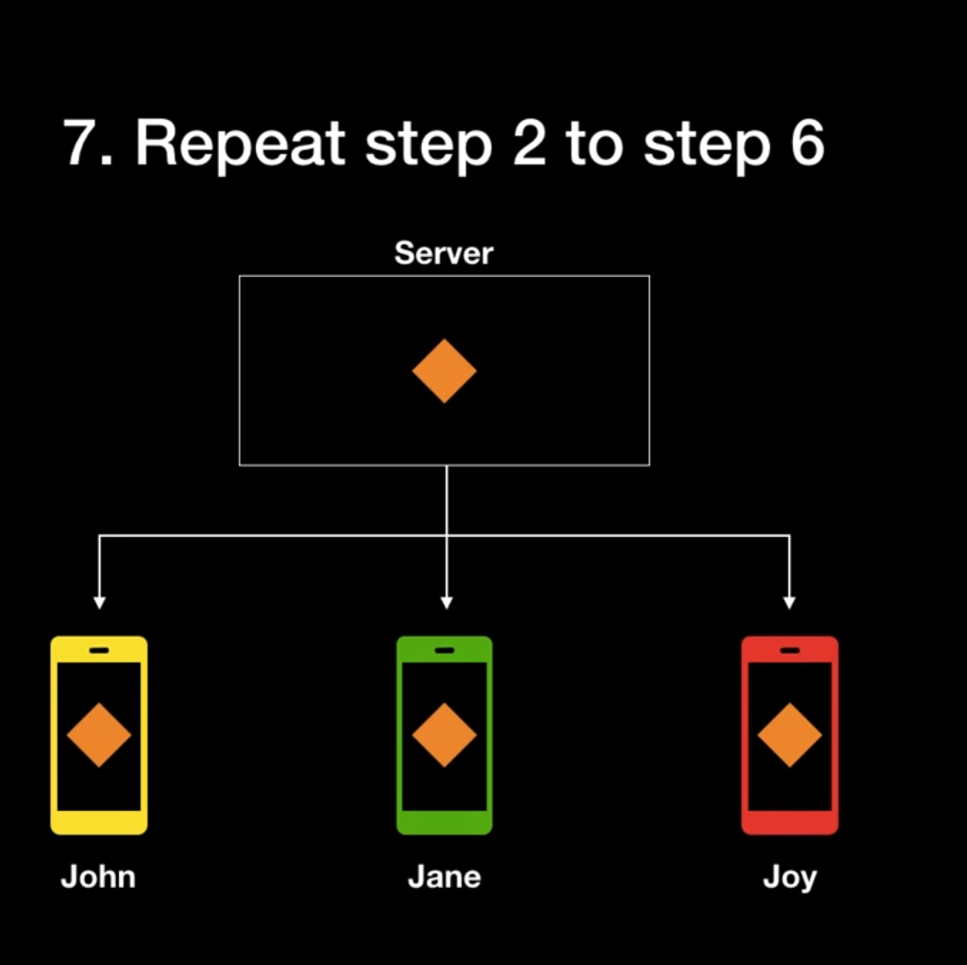
Future Scopes:
Federated learning can be applied
Multi-language BERT Model
AI with crowdsourcing can be used for better performance

Slide 14




Results
Disputed Content
Model Size | Device | CPU
0.6Mb | Pixel 3 (Android 10) | 0.05ms*
 | Pixel 4 (Android 10) | 0.05ms*
 | iPhone XS (iSO 12.4.1) | 0.025ms**
Source: https://www.tensorflow.org/lite/models/text_classification/overview

Slide 15
Demo Links
Demo Video (Change Video quality while streaming - 720p and 1080p recommended):
https://drive.google.com/file/d/1LIq4VCGzQF33yMfFtMo3zmfbVjhaQSEL/view?usp=sharing
APK:
https://github.com/Tesseractpy/Tesseractpy/blob/master/Whatsapp.apk
GitHub Repo:
https://github.com/Tesseractpy/Tesseractpy

Slide 16


